Slide 1
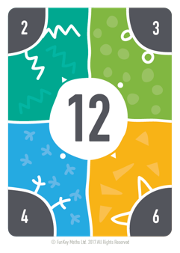
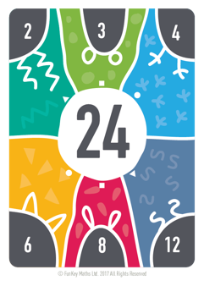
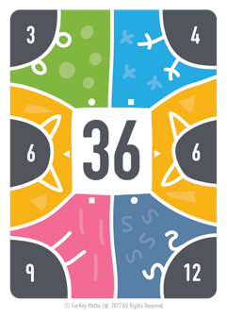
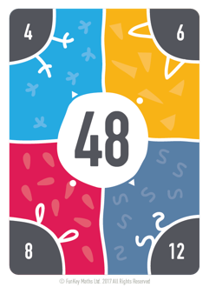
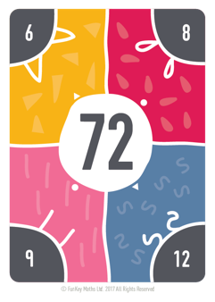
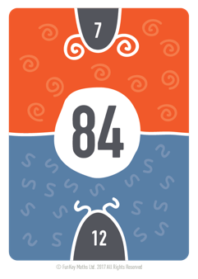
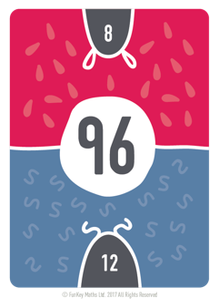
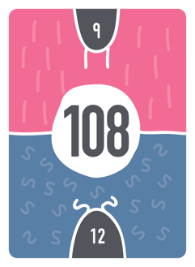
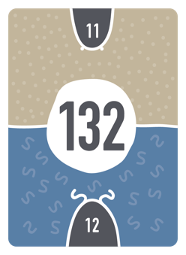
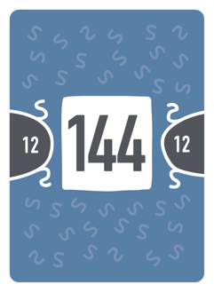
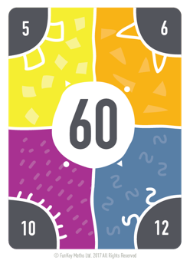
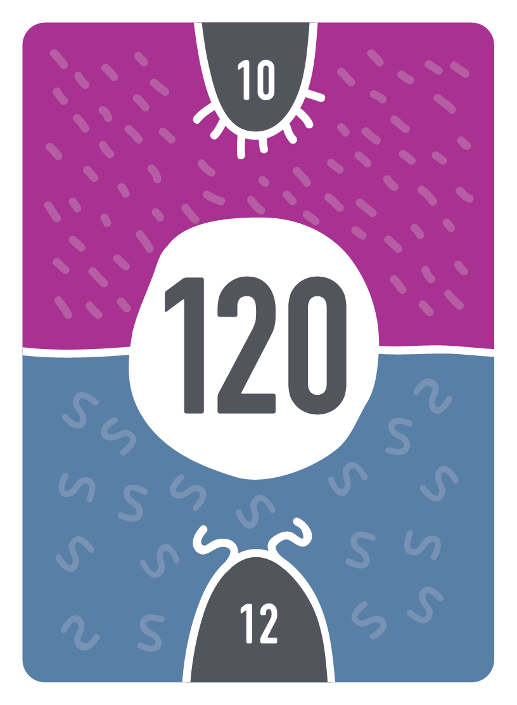
Step counting in 12s

Slide 2

Step counting in 12s

Slide 3
Step counting in 12s

Slide 4
Step counting in 12s

Slide 5
Step counting in 12s

Slide 6
Step counting in 12s

Slide 7
Step counting in 12s

Slide 8
Step counting in 12s

Slide 9
Step counting in 12s

Slide 10
Step counting in 12s

Slide 11
Step counting in 12s

Slide 12
Step counting in 12s

Slide 13
Step counting in 12s

